Slide 1
Types of kernels in operating systems
Jelena Matijaš 1102/23

Slide 2
Contents:
About kernel
Types of kernel
Monolithic kernel
Microkernel
Hybrid kernel
Nanokernel
Exokernel
Summary and conclusion

Slide 3
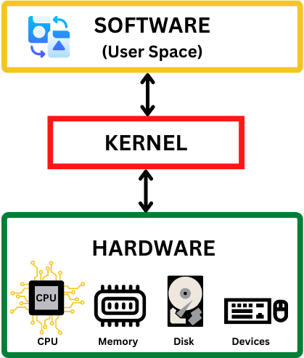
What is a kernel?
Core of the operating system, with complete control over everything in the system
One of the first programs loaded
Manages input/output requests from software and memory
Process management, hardware device management…
Notes:
The kernel is a computer program that serves as the core of the operating system, with complete control over everything in the system. It is one of the first programs loaded during startup. The kernel manages the rest of the boot process as well as input/output requests from software, converting them into data-processing instructions for the CPU. It manages memory and peripheral devices such as the keyboard, monitor, printer, etc.
The critical kernel code is usually loaded into a separate memory area that is protected from access by application software or other less critical parts of the operating system. The kernel performs tasks such as process management, hardware device management (HDD, network adapters…), and handling interrupts inside a protected space. Accordingly, everything the user does is executed in user space. This separation prevents user and kernel data from mixing and stops faulty or malicious application programs from crashing the entire operating system. When a process requires a service from the kernel, this is called a system call. The primary function of the kernel is to act as a bond between the user and computer resources—that is, managing the CPU, memory, and devices.

Slide 4
Types of kernel
Monolithic kernel
Microkernel
Hybrid (modular) kernel
Nanokernel
Exokernel

Slide 5
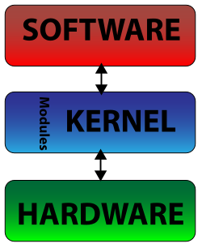
Monolithic kernel
Entire operating system runs in kernel space
Contains all essential OS functions and device drivers
✅Less software, smaller, fewer bugs…
✖️Challenging coding, large and complex, not bug safe, poor portability

Slide 6
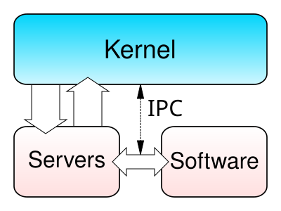
Microkernel
System functionality moved from the traditional kernel into a set of servers
A simple abstraction over hardware
✅Smaller and easier to maintain, shorter development time
✖️Higher RAM usage, more software layers, Message-passing errors are harder to debug, large number of system calls and context switches …

Slide 7
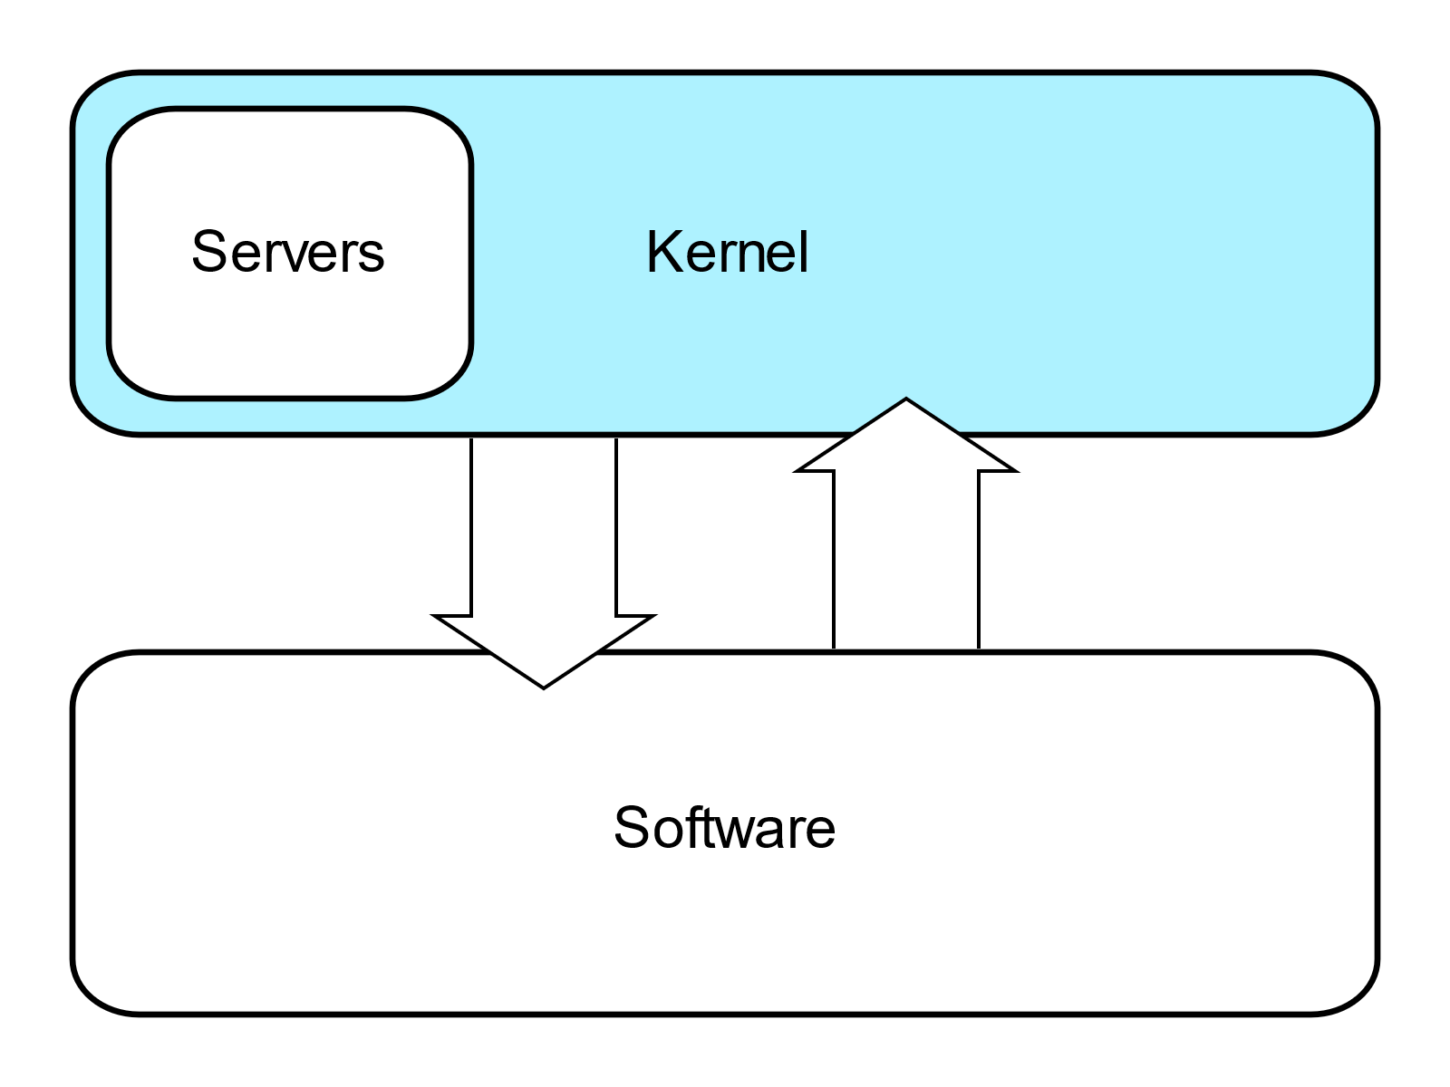
Hybrid (Modular) kernel
Similar to a microkernel but includes additional code in kernel space to improve performance
It can be understood as a microkernel containing some non-essential code
✅Shorter development time, no need to recompile everything
✖️More security vulnerabilities, module maintenance may be confusing

Slide 8
Nanokernel
A nanokernel delegates virtually all services (even basic ones such as interrupt controllers or timers) to device drivers to make the kernel even smaller than a microkernel.

Slide 9
Exokernel
Experimental OS kernel design
Functionality is limited to protecting and multiplexing hardware resources, without providing hardware abstractions
Extremely small, but it is accompanied by an OS library
Main advantage is that multiple OS libraries can be included

Slide 10
Summary and conclusion
Monolithic kernel have everything in one space – kernel space.
Microkernels have separated kernel and user space.
Hybrid kernels combine the best practices from above kernel types.
Nanokernels delegate virtually all services.
Exokernel is for experimental use.

Slide 11
Questions?

Slide 12
Thank you!

